Slide 1
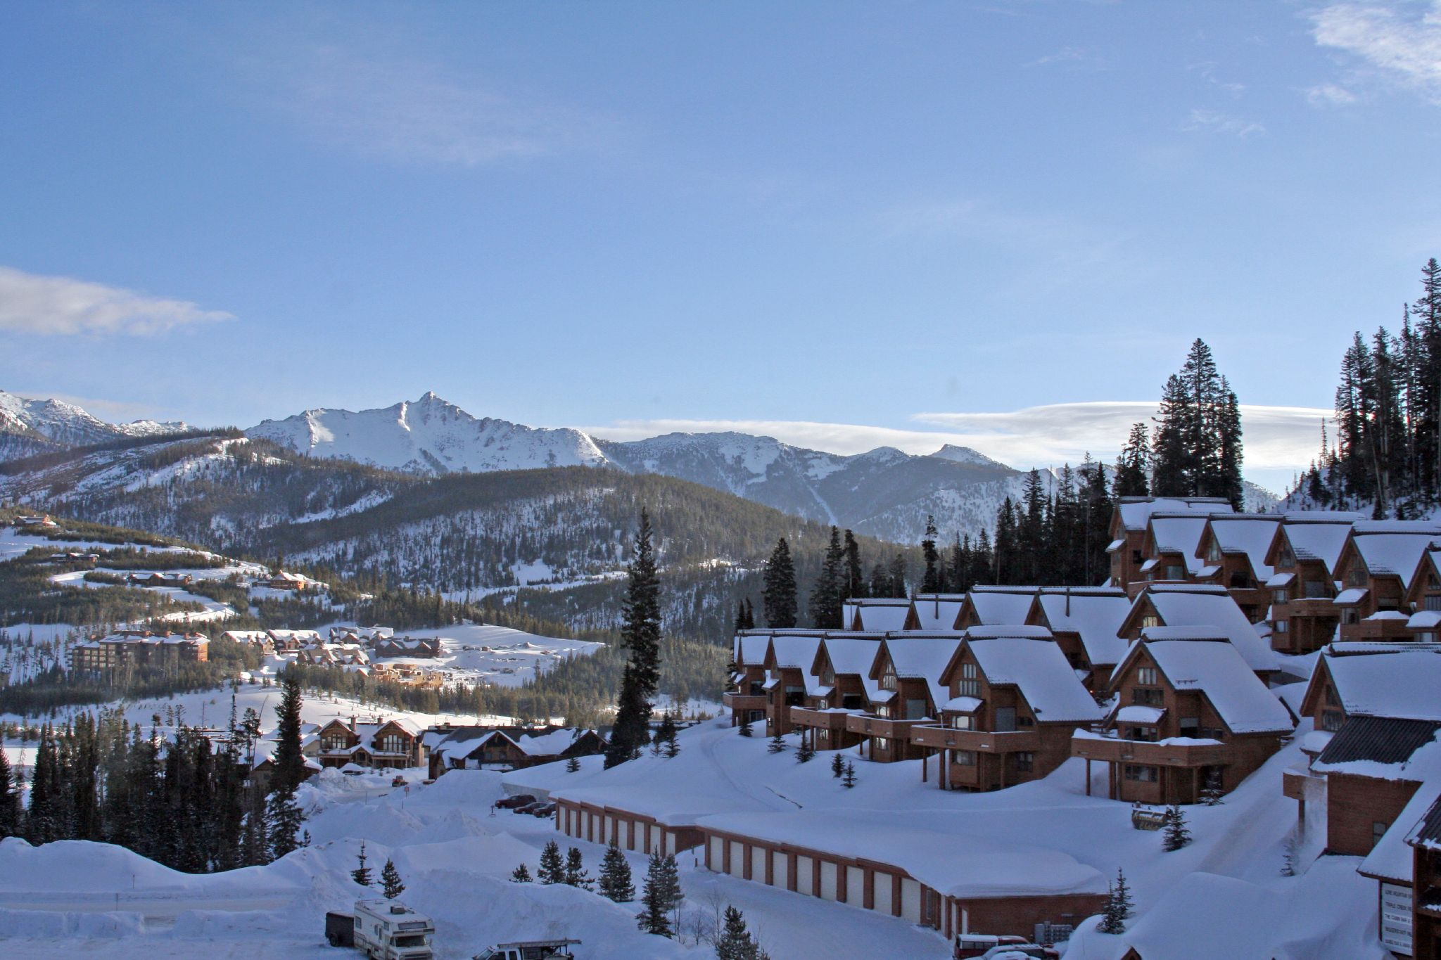
Big Mountain Resort
Guided Capstone
M Tariq Aziz

Slide 2
Problem Identification
How should Big Mountain Resort select better value for their ticket price of over 300 US resorts.
Business team needs a new strategy based on their data science team’s predictive model for future investments.
Due to the installation of additional chair lift, their operating cost increases by $1.5Million this season. They are considering number of changes either cut costs or support higher ticket prices
Success of this project = maintain atleast 350K visits per year while slightly increasing the ticket prices
Installation of new facilities are out of scope
Facing heat for business and executive partners
Excel format with limited data availability
Don’t have the ability to upgrade equipment

Slide 3
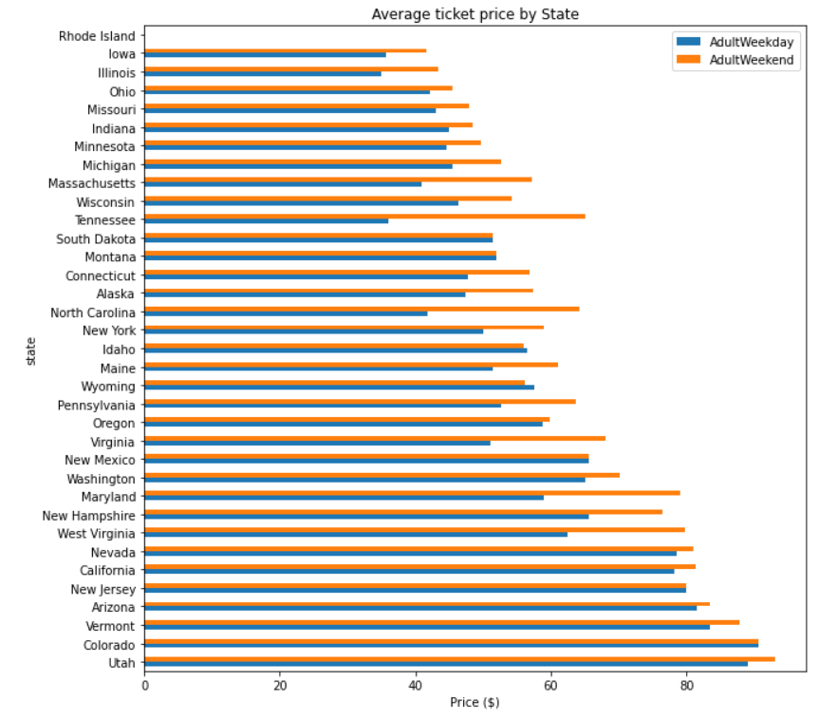
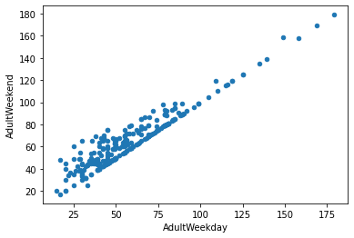
Recommendation & Key Findings
Based on the best model selection, we found that one type of model, Random Forest, with the optimum amount of features, and 8 variables, could model ticket pricing the best
Big Mountain currently charges $81. Based on Big Mountain's features, this model predicts that a price consistent with the market can be $95. Even with the expected mean absolute error of $10.39, this suggests there is room for a price increase. Additionally, the model can predict ticket prices in scenarios such as adding infrastructure, which the Big Mountain execs may want to use

Slide 4
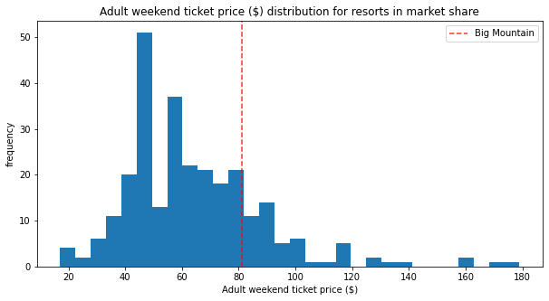
Modeling Results and Analysis
Resort ticket price modeling relies on the assumption that other resort in big mountain competitors setting the price based on what people value at certain facilities.
The resort’s actual prices were around $81 and $95 with the mean absolute error of $10.39, suggest that their is a room for price increase.

Slide 5
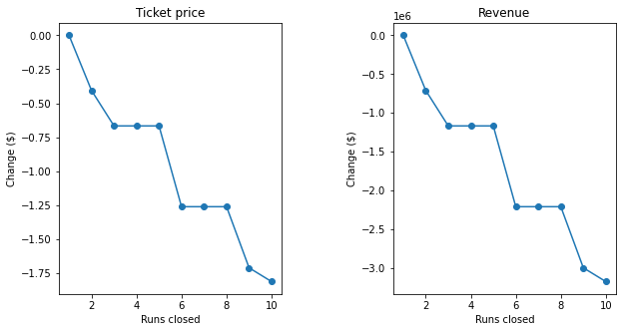
Modeling Results and Analysis
Model also suggests that the number of visitors remain the same over the years.
The resort also looking to cut some facilities if they have to or increase the ticket price to sustain the reasonable profit. Keep in mind that resort is independent of setting the prices.

Slide 6
Modeling Results and Analysis
The resort wants to look at four different scenarios.
First scenario is to close permanently 10 of the least used runs. The model says closing one run makes no difference. Closing 2 and 3 successively reduces support for ticket price and so revenue. If Big Mountain closes down 3 runs, it seems they may as well close down 4 or 5 as there's no further loss in ticket price. Increasing the closures down to 6 or more leads to a large drop.
Second scenario, increase the vertical drop by 150 feet and install an additional chair lift. This scenario increases support for ticket price by $8.61 with the expected revenue to be $15065471.
Adding two acres of snow making could increase the revenue by $17322717 if price is set to $9.90. It makes so such difference, this is scenario three.
Last scenario, if the longest run increase by 0.2 miles, guaranteeing its snow covering by adding four acres of snow making capability, will not going to make any difference respectively.

Slide 7
Summary and Conclusion
The lack of visitors per season or year numbers was inhibiting our analysis.
It also would have been helpful to see a breakdown of costs, like how many employees are needed per run, equipment cost or per other variables.
Our model told us that Big Mountain was undercharging, but maybe it has a bad reputation for some reason, or other information affecting the situation that was not in the data.
It would need to be a conversation with the executives, and it would be good to know if there was a previous model that gave the $81 price.
Furthermore, we can play with other parameters to see how they affect the model.

